Slide 1
Unit 3 Cascading Style Sheets
Amanpal Singh Rayat

Slide 2
Introduction To CSS: Inline CSS, internal CSS and external CSS
CSS rules like link and style
Types of CSS
CSS properties like text controlling and text formatting
CSS selectors like type, id, class.
Introduction To CSS and types of CSS
CSS Box Model- Padding, Margin, Border
Div and Span Tag in CSS
Working with background Images

Slide 3
div and span tags in CSS.
Display: <div> is a block-level element, while <span> is an inline element.
Usage: Use <div> for larger sections of content and layout purposes. Use <span> for styling specific parts of text within a block.
<div class="container"> <h1>Welcome to My Website</h1> <p>paragraph</p> </div>
.container { background-color: #f0f0f0; padding: 20px; border: 1px solid #ccc;}
<p>This is a <span class="highlight">highlighted</span> word in a paragraph.</p>
.highlight { color: red; font-weight: bold; }

Slide 4
1. Introduction to CSS
Definition: CSS (Cascading Style Sheets) is used to style and layout web pages.
Purpose: Separate content (HTML) from presentation (CSS).

Slide 5
2. Types of CSS
Inline CSS: Styles applied directly within HTML elements.
<p style="color:blue;">This is a blue paragraph.</p>
Internal CSS: Styles are written inside the <style> tag in the <head> section.
<style> p { color: blue; } </style>
External CSS: Styles are defined in an external file.
/* styles.css */
p { color: blue; }
<link rel="stylesheet" href="styles.css">

Slide 6
3. CSS Rules
Linking CSS: Using the <link> tag in HTML.
<link rel="stylesheet" href="styles.css">
Style Tag: Using the <style> tag within HTML.
<style> p { color: blue; } </style>

Slide 7
4. CSS Selectors
Type Selector: Selects all elements of a given type.
p { color: blue; }
ID Selector: Selects an element with a specific ID.
#unique-element { color: red; }
<p id="unique-element">This is a red paragraph.</p>
Class Selector: Selects all elements with a specific class.
.highlight { background-color: yellow; }
<p class="highlight">This paragraph is highlighted.</p>

Slide 8
5. CSS Properties
Text Controlling:
color: Sets the text color. p { color: green; }
font-size: Sets the text size. p { font-size: 20px; }
text-align: Aligns the text. p { text-align: center; }
Text Formatting:
font-weight: Sets the weight (boldness) of the text.
p { font-weight: bold; }
text-decoration: Adds decorations to the text (e.g., underline).
p { text-decoration: underline; }

Slide 9
6. CSS Box Model
Padding: Space between the content and the border.
div { padding: 10px; }
Margin: Space outside the border.
div { margin: 15px; }
Border: Surrounds the padding (or content if no padding is applied).
div { border: 2px solid black; }

Slide 10
7. Div and Span Tags
Div: Block-level container.
<div style="background-color:lightblue;">
<p>This is inside a div.</p>
</div>
Span: Inline container.
<p>This is a <span style="color:blue;">blue</span> word.</p>

Slide 11
<div> | <span>
The <div> tag is a block level element. | The <span> tag is an inline element.
It is best to attach it to a section of a web page. | It is best to attach a CSS to a small section of a line in a web page.
It accepts align attribute. | It does not accept align attribute.
This tag should be used to wrap a section, for highlighting that section. | This tag should be used to wrap any specific word that you want to highlight in your webpage.

Slide 12
8. Working with Background Images
Setting a Background Image:
body { background-image: url('background.jpg'); }
Controlling Background Properties
background-repeat: Repeats the background image.
body { background-repeat: no-repeat; }
background-size: Resizes the background image.
body { background-size: cover; }

Slide 13
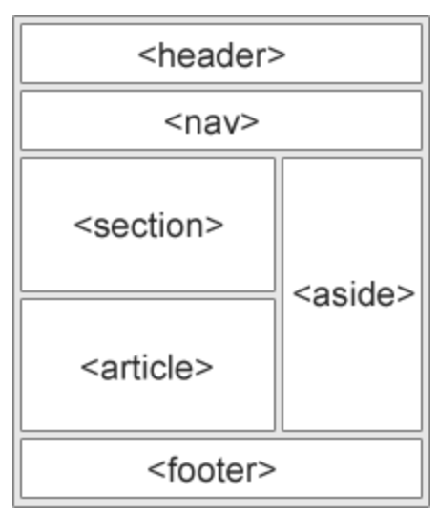
HTML Layout Elements
HTML Layout Techniques
HTML tables (Try not to use)
CSS float property
CSS framework
CSS flexbox
Layout using div

Slide 14
HTML Layout Elements: example
<body> <style>
body { display: flex; background-color: rgb(224, 136, 22); flex-direction: column; margin: 0%; height: 100vh; font-size: large; }
header, footer{background-color: brown; text-align: center; padding: 1em;}
nav{ background-color: aqua; text-align: center; padding: 1em;}
nav a{ background-color: rgb(217, 226, 43);}
main{ background-color: azure; display: flex; height: 100vh; }
section{ background-color: burlywood; width: 80%; }
aside{ background-color: darkgoldenrod; width: 20%;}
</style>
height: 100vh => 100% of the viewport height.

Slide 15
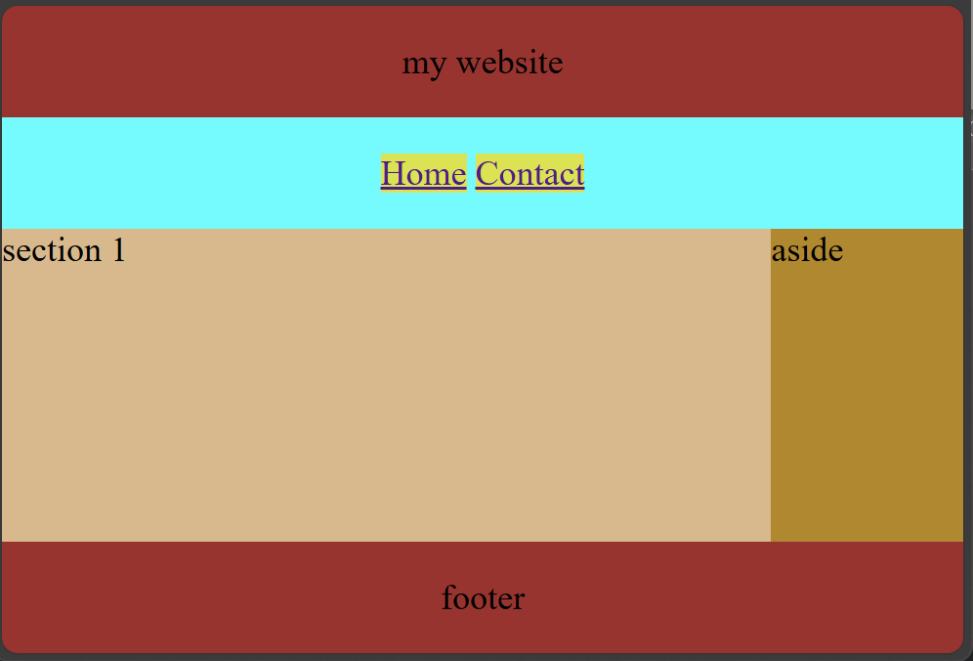
<header>my website</header>
<nav> <a href="#">Home</a> <a href="#">Contact</a> </nav>
<main>
<section>section 1</section>
<aside>aside</aside>
</main>
<footer>footer</footer>
</body>

